Slide 2
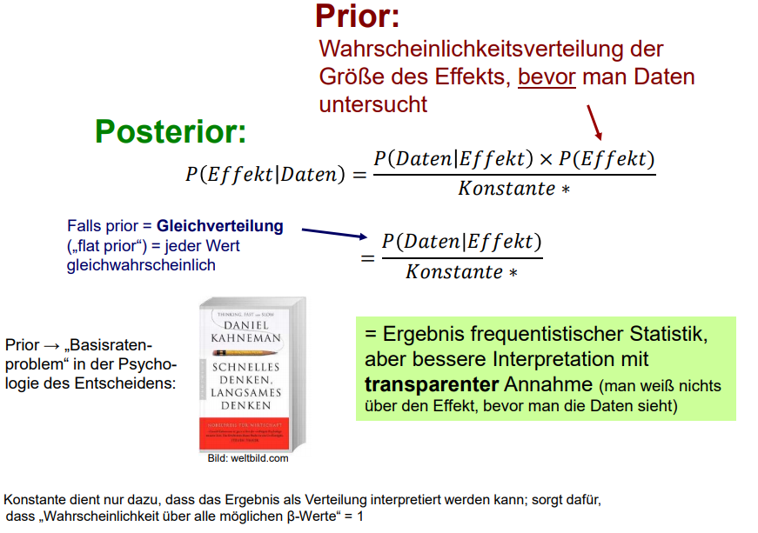
Prequel ML from a bayesian point of view
Likelihood
Neural Networks actually calculate (maximize) the Likelihood. Given Data → get model that best explains the data
In this context, the „Effekt“ is aquivalent to the class wen would like to detect and prior can be seen as the network architecture.
If enough data is available (i.g. not the case), any prior will vanish out. But „bad“ prior don‘t exist. (some just dont help much… :-) )
©
Michael Höfler TUD

Slide 3
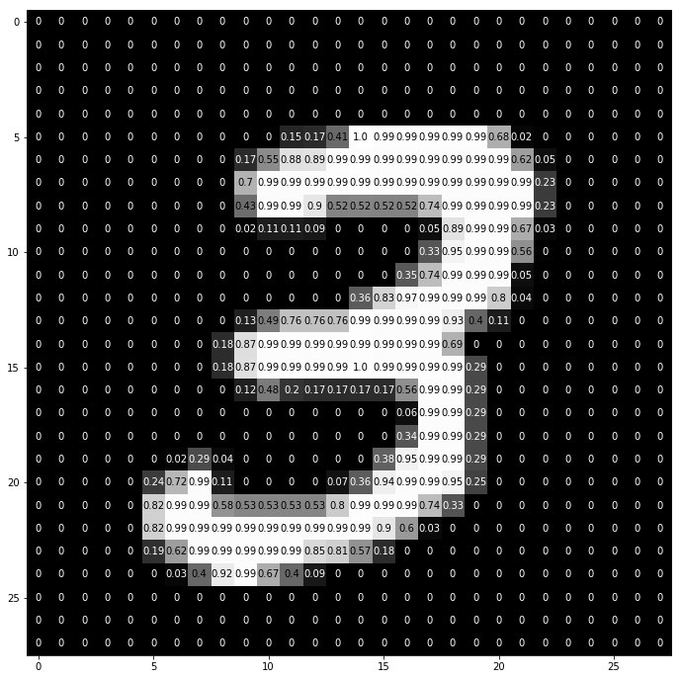
Image Data
For a computer, images are just numbers. But there is one prior from years of image analysis that we can make use off: Neighbour pixels are often correlated!

Slide 4
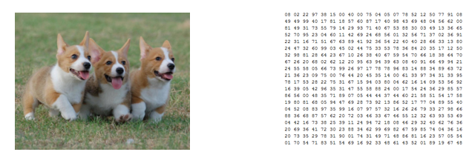
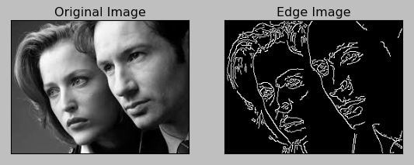
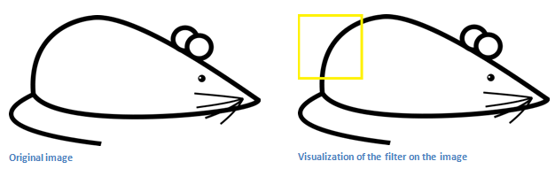
Priors Images
In image analysis there is an algorithm that uses this effect to investigate specific areas of an image. This function is called (discrete) convolution. In classic CV research this was utilized together with (predefined) detectors or filters.
Example: Sobel Filter (Edge Detector)

Slide 5
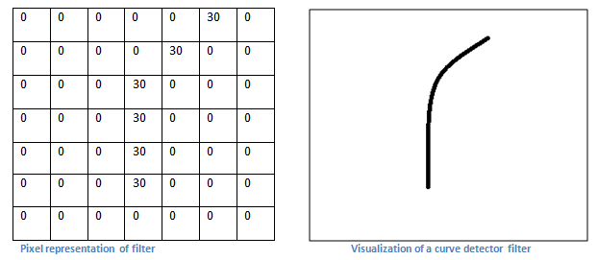
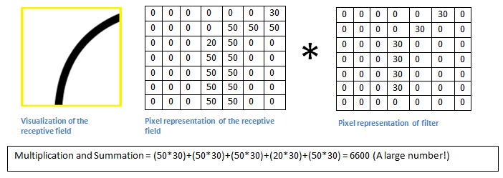
Convolutional Neural Networks Intuition
These filters can be convoluted with the image to detect the feature the filter was designed to detect by human image experts. In general a filter is just a matrix of numbers and the (discrete) convolution is simplified to a simple vector-matrix product – simple multiplication and summation.
Example: Detecting a specific line
Basically, in the input image, if there is a shape that generally resembles the curve that this filter is representing, then all of the multiplications summed together will result in a large value!

Slide 6
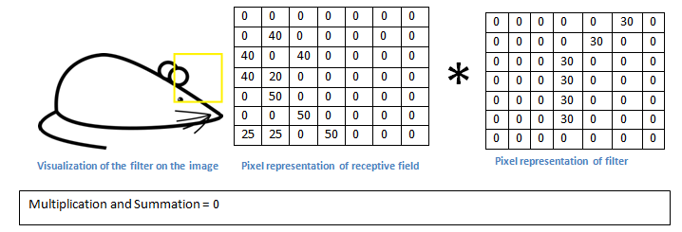
Convolutional Neural Networks Intuition
Now let’s see what happens when we move our filter.
The value is much lower! This is because there was nothing in the image section that responded to the curve detector filter.
All previous filters we have seen, have been handcrafted. But the design of these filters is very time consuming and sometimes not even possible for human experts.
Idea: Use Neural Networks learn the filter!

Slide 7
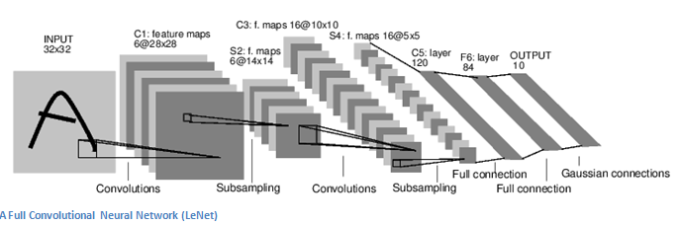
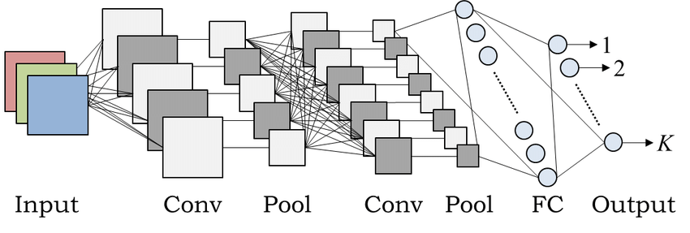
Convolutional Neural Networks
The go to algorithm for images!
Simple:
First approach: LeNet (Yann LeCun, 1998)
feature maps
MLP
Layer 1
Layer 2
Layer 2
Interpret the values of our filter as the weights from our previous neural networks that we want to optimize.
The forwards pass is exactly the already mentioned convolution of this initialized filter with our image. Usually multiple featuremaps are initialized and trained. This is analog to the neurons in the MLP case.

Slide 8
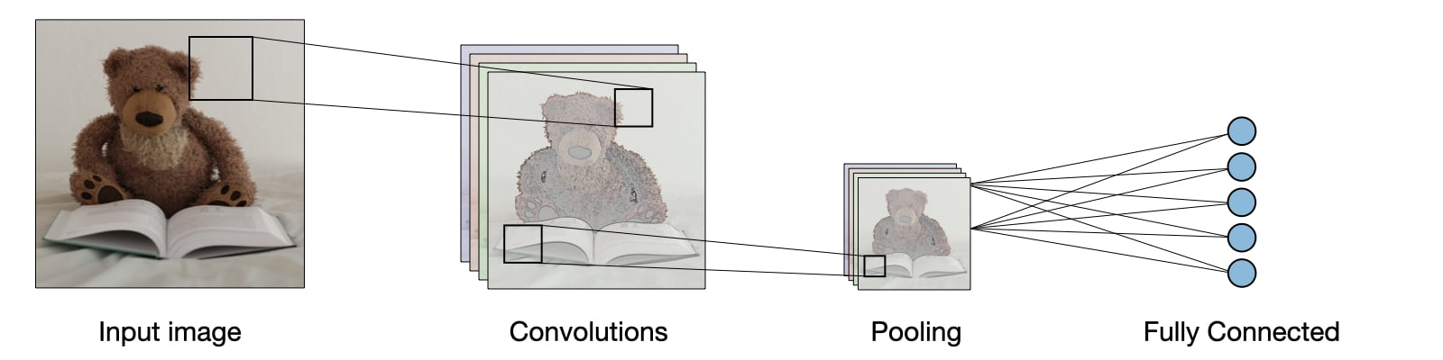
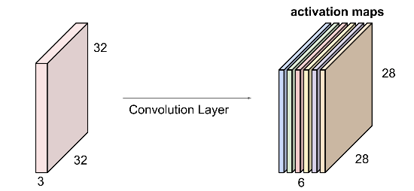
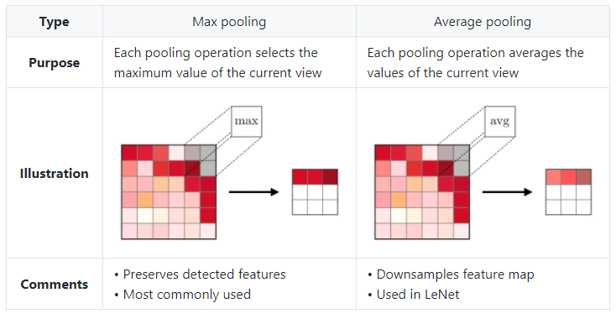
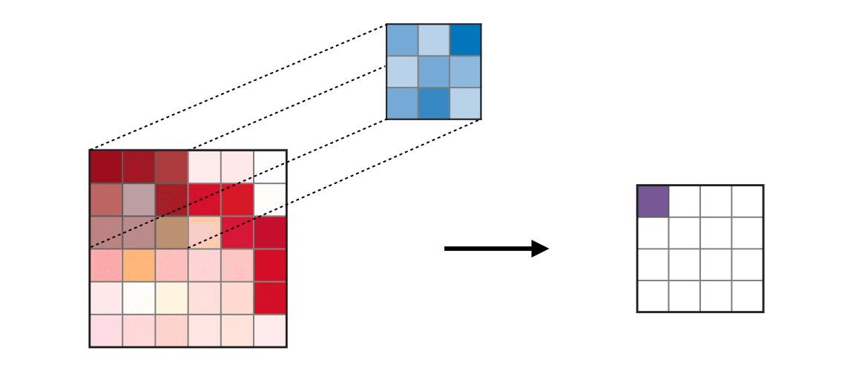
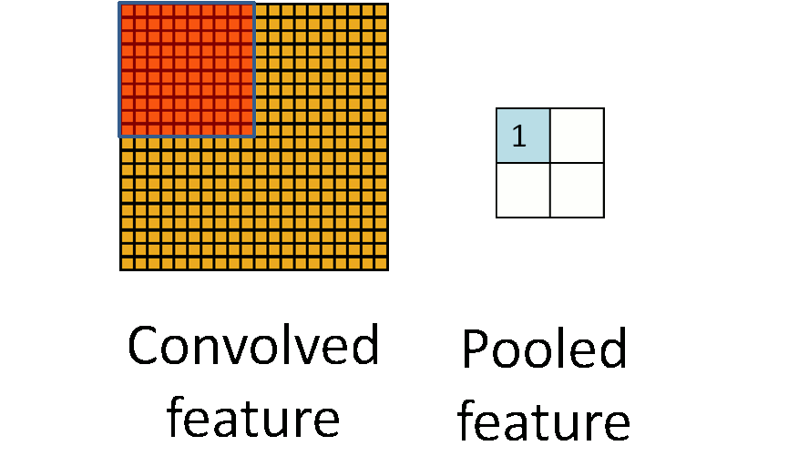
The feed forward path is the already mentioned sliding convolution of the filter over the image with two additions:
1) The output of the convolution = x is processed by an activation function (e.g. ReLu) before handing to the next layer.
2) After each Conv. layer, a pooling crops the receptive field for the next layer.
Multiple feature maps per layer!
Convolution
Pooling
Activation(x)
blue to violet

Slide 9
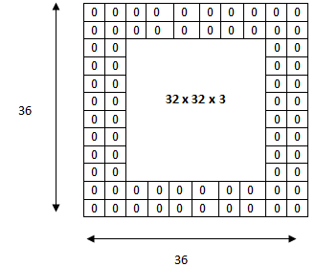
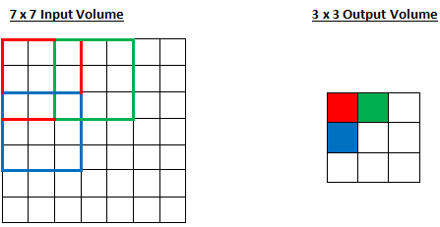
Convolutional Neural Networks Stride & Padding
For a convolutional or a pooling operation, the stride S denotes the number of pixels by which the window moves after each operation
Zero-padding denotes the process of adding PP zeroes to each side of the boundaries of the input.

Slide 10
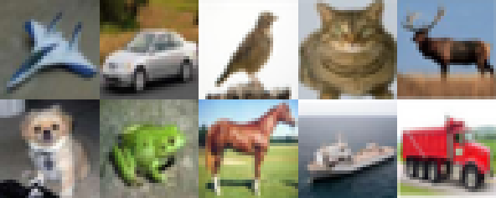
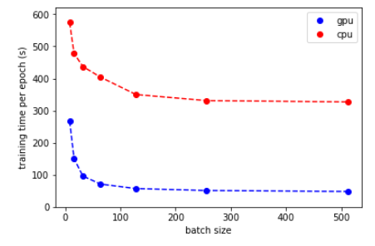
Cifar10
Our previous datasets are far to easy for Convnet to solve! Here, we will analyse Data from the Cifar10 Dataset, a very well known image recognition benchmark.
32x32 pixel RGB images
10 classes
50,000 training images
10,000 test images
For brevity we will start with only 2 classes in the Dataset: Cats and Dogs.
Training time has become a limiting factor in AI research today. But thankfully, subsets of sampels in a training batch can be calculated in parallel on a GPU’s:
GPU4
GPU3
GPU2
batch4
GPU1
batch3
batch2
Remember:
We update weights after each batch!)
batch1

Slide 11
5. Exercise Let‘s train our first CNN classifier for cats and dogs with Keras!

Slide 12
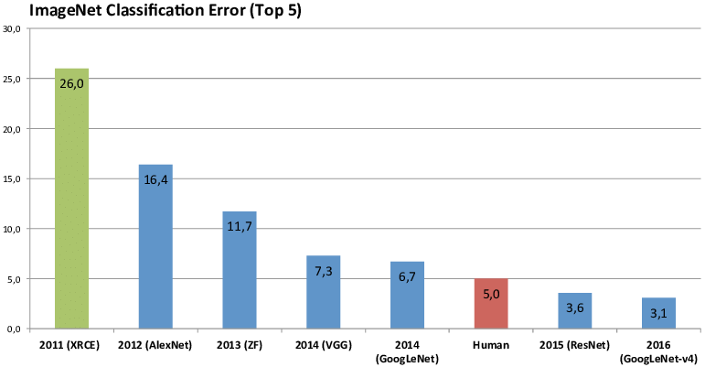
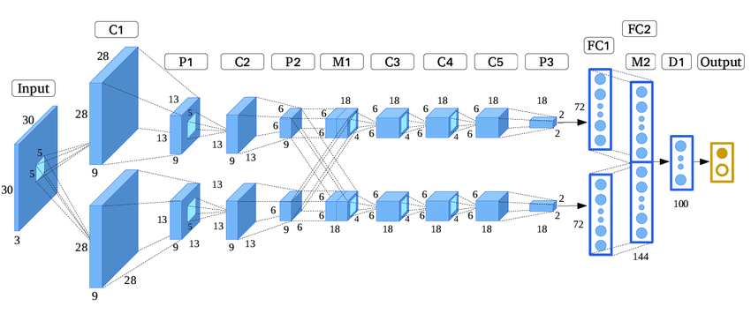
ImageNet
Another famous dataset for benchmarking Image recognition algorithms. Tiny ImageNet dataset has 100,000 images across 200 classes.
First remarkebel CNN: AlexNet 2012
Comparrison to LeNet:
- 2 Paths possible
X – connections
Filters number increasing with layer
2012 marked the first year where a CNN was used to achieve a top 5 test error rate of 15.4%.

Slide 13
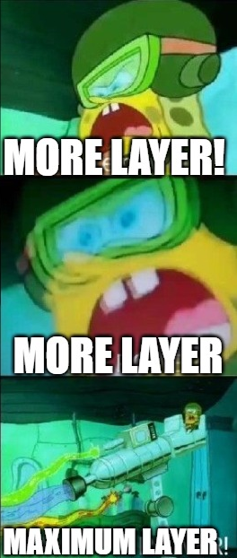

VGG16
Winner of 2014 with 19 Layers!

Slide 14
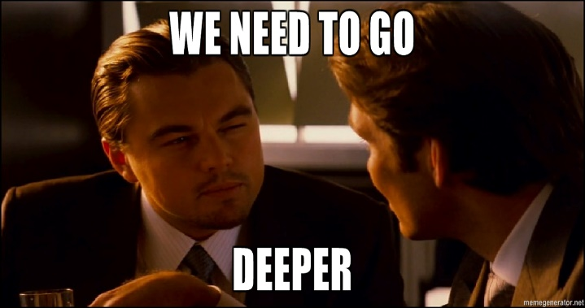

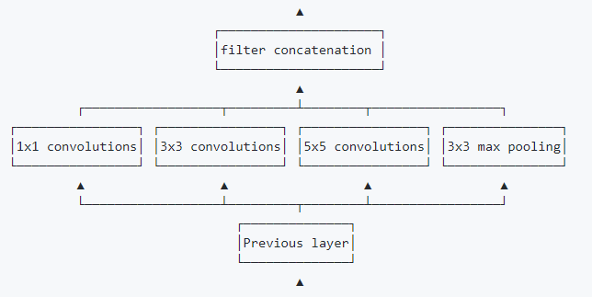
Google LeNet (Inception v1)
Inception module
9 Inception modules, 22 layers (blue)

Slide 15
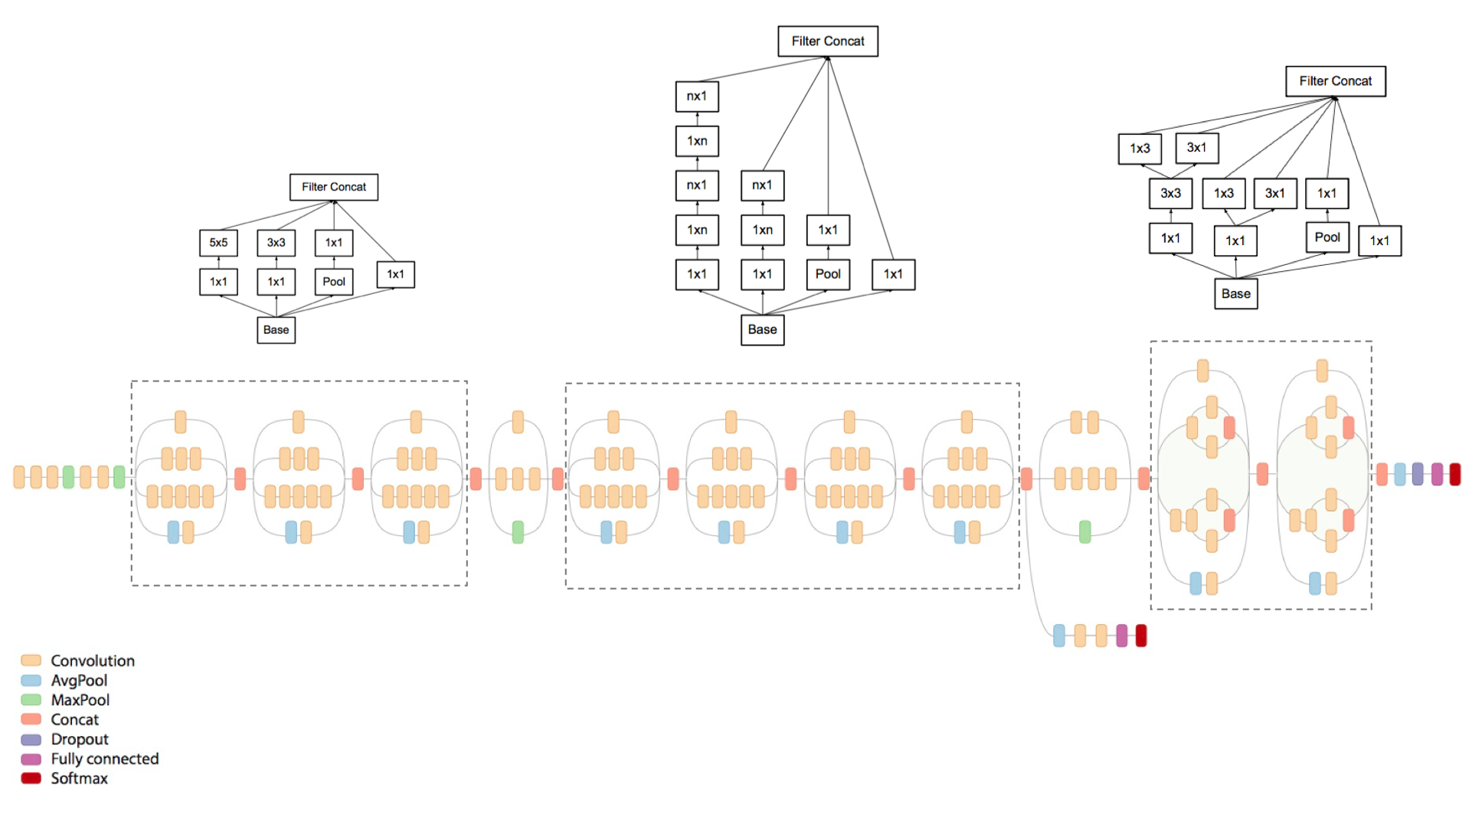
Google LeNet (Inception v2,3)
A 5x5 filter size is 2.78 times more computationally expensive than a 3x3 layer with the same number of filters!
Another important change was the use of Batch Normalization (BatchNorm)

Slide 16
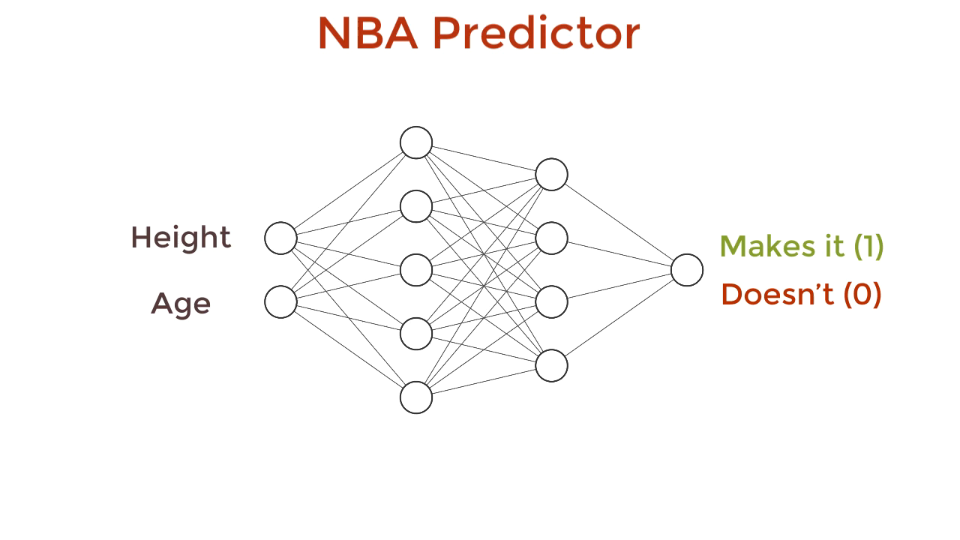
Batch Normalization
Input
Conv
BN
Conv
BN
FC
BN
Softmax
Output

Slide 17
6. Exercise Let‘s regularize our first CNN classifier with BatchNorm!

Slide 18
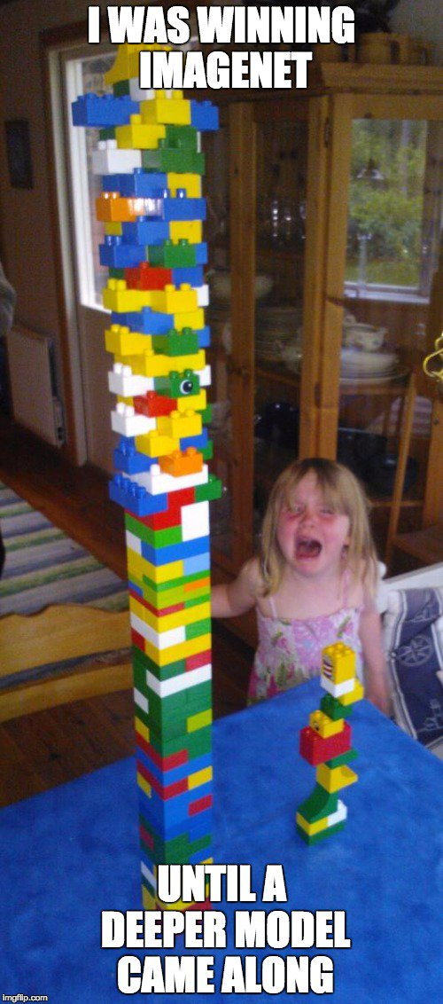
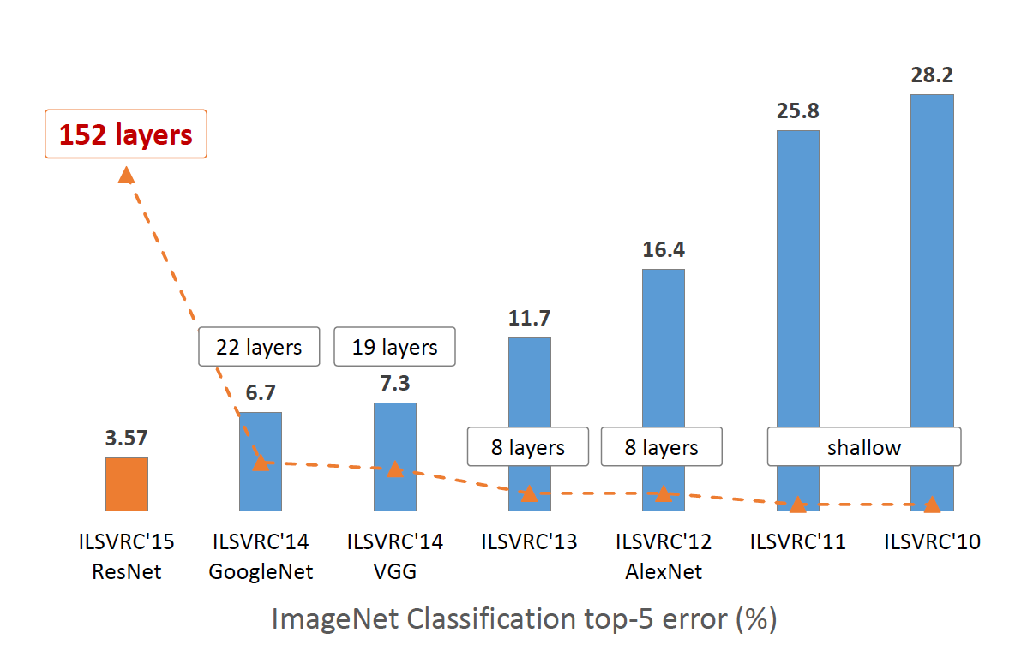
Google

Slide 19
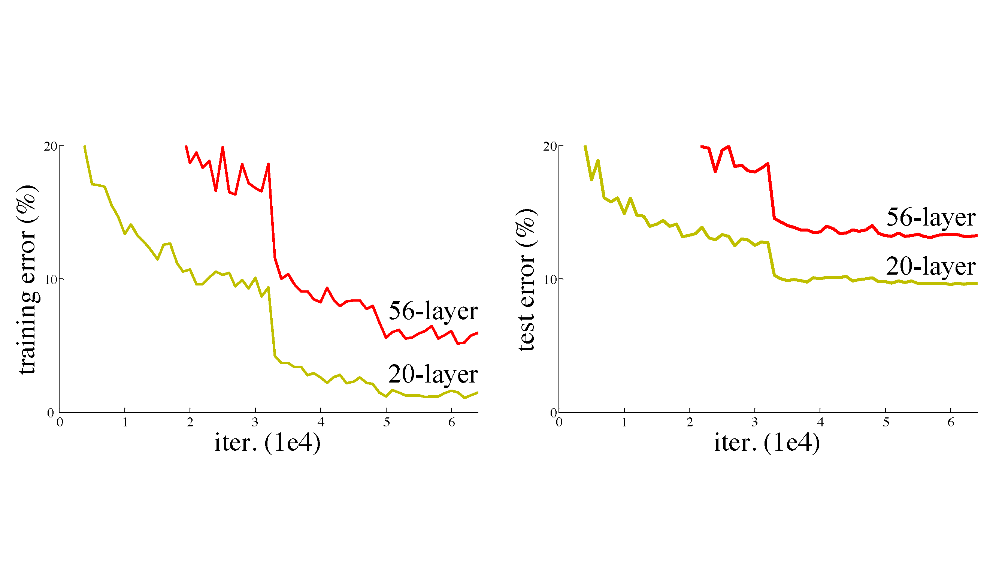

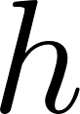

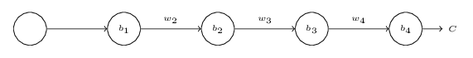
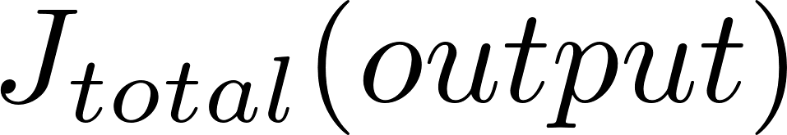



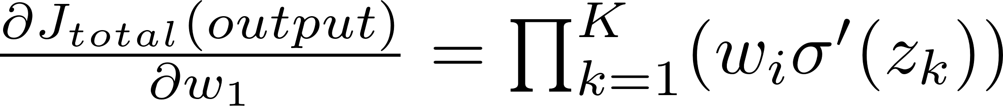
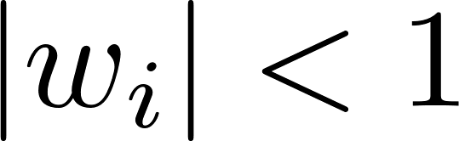
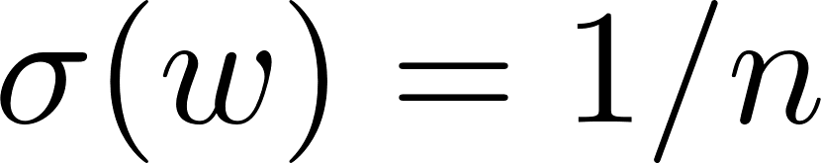
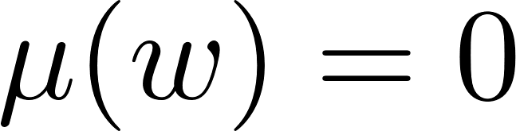
Vanishing Gradient
Is learning better networks as easy as stacking more layers?
Cifar10 for deeper VGG Network
Google
Number of layers
mostly:
Glorot/He:
→
Regularization is also supposed to keep them small!

Slide 20
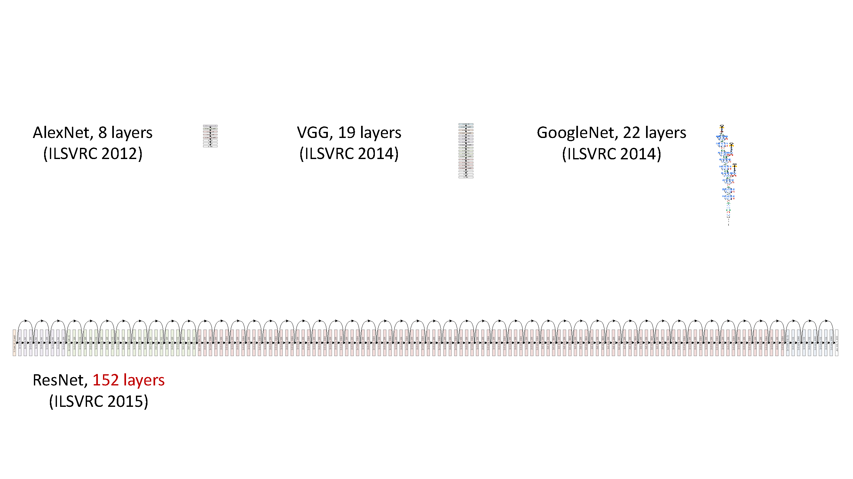
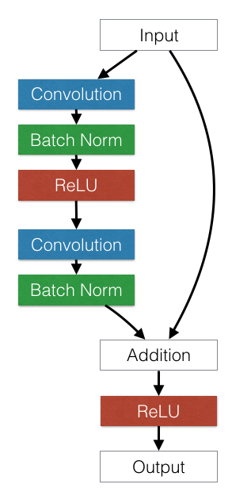
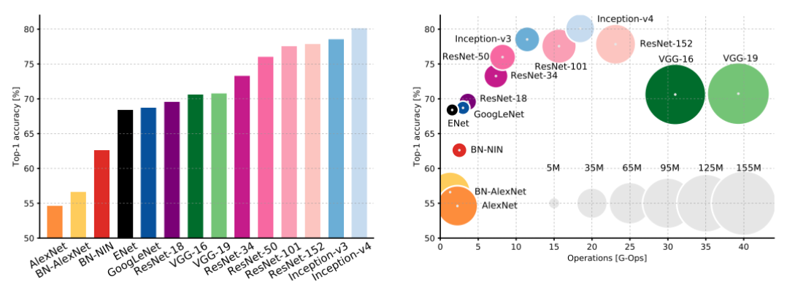
ResNet
ResNet introduced skip connections that allowed a flexible gradient highway. It is not a fix to vanishing gradient but it allowed models more resilient, so larger models can be trained!
Google

Slide 21
7. Exercise Let‘s train a ResNet an other CNN Classifiers on the full Cifar10 dataset!

Slide 22
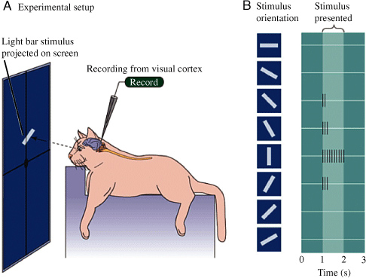
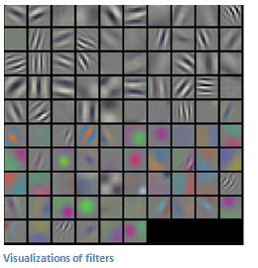
Feature Visualization Activation Map plotting
Now that we know the basics, we can plot the output of the feature maps activation given an input image. This is a test how the respective layer is reacting and gives a hint what the network might have learned while training.
The results are fascinating, especially if you compare them to the experiment from Hubel and Wiesel 1962.
fascinating experiment by Hubel and Wiesel in 1962

Slide 23
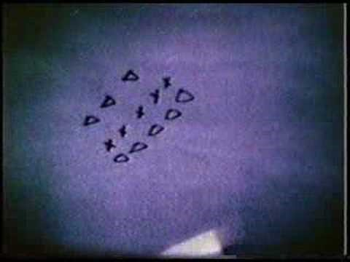

Slide 24
8. Exercise Let‘s plot our activation maps of the CNN classifier with Keras!

Slide 25
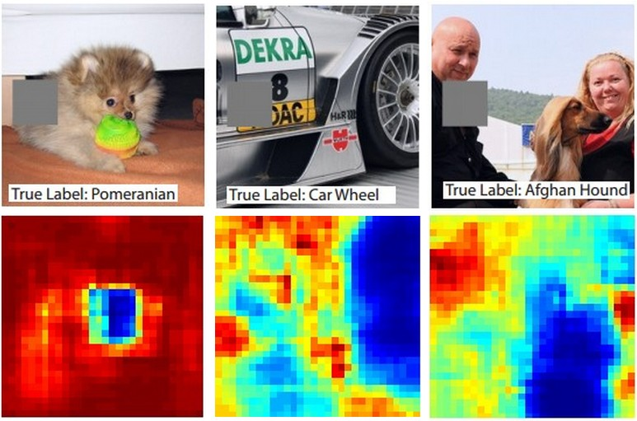
Feature Visualization Occluding parts of the image
Matthew Zeiler:
Visualizing and Understanding Convolutional Networks (2013)
What part of an Image is relevant to a Neural Networks decision?
A native approach to this is the occlusion of specific sections in an Image.
Here we iterate over regions of the image, set a patch of the image to be all zero, and look at the probability of the class.

Slide 26
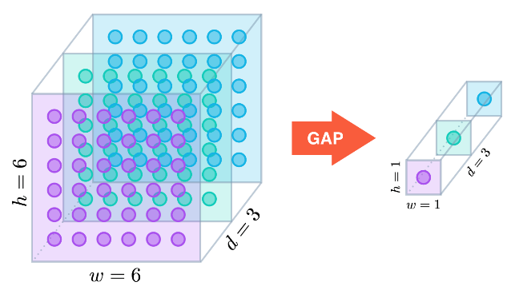
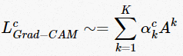
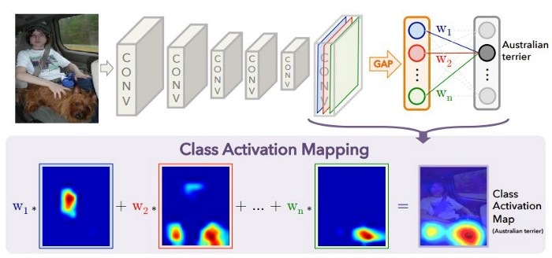
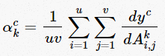
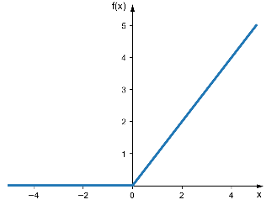
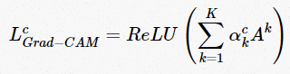
Class Activation Maps (CAM) CAM and GradCam
Global Average Pooling (GAP)
We have seen that Convolutional feature maps retain spatial information, which is lost in fully-connected layers (MLP). Last Conv Layer can be thought as the important features for the classification.
Classificate from these feature Maps after using GAP and sum the weighted positive feature Maps =CAM (make them positive by ReLu(x))
Compute the GAP pooled gradient of the last layer
v =6
u =6
Number of FMaps
Weight (Cam)
= CAM
Feature Map
GAP of Gradient
(GradCam)
ReLu
= GradCAM
ReLu because we are only interested in the features that have a positive influence on the class of interest

Slide 27
9. Exercise Lets train a feature visualisation algorithm! (GradCAM)

